Slide 1

Analysis of Fatal Crash Data - Australia
1989-2020
1
Interesting Questions
2
Information about the data
3
Data Exploration and Clean Up Process
4
The Analysis Process
5
Conclusions
6
Implications

Slide 2
Questions?
How has the rate of road fatality trended over time?
Are there any factors that increase the risk of crash fatalities?
Areas to consider:
^{demographic}
^{geographic}
^{time}
^{vehicular}

Slide 3

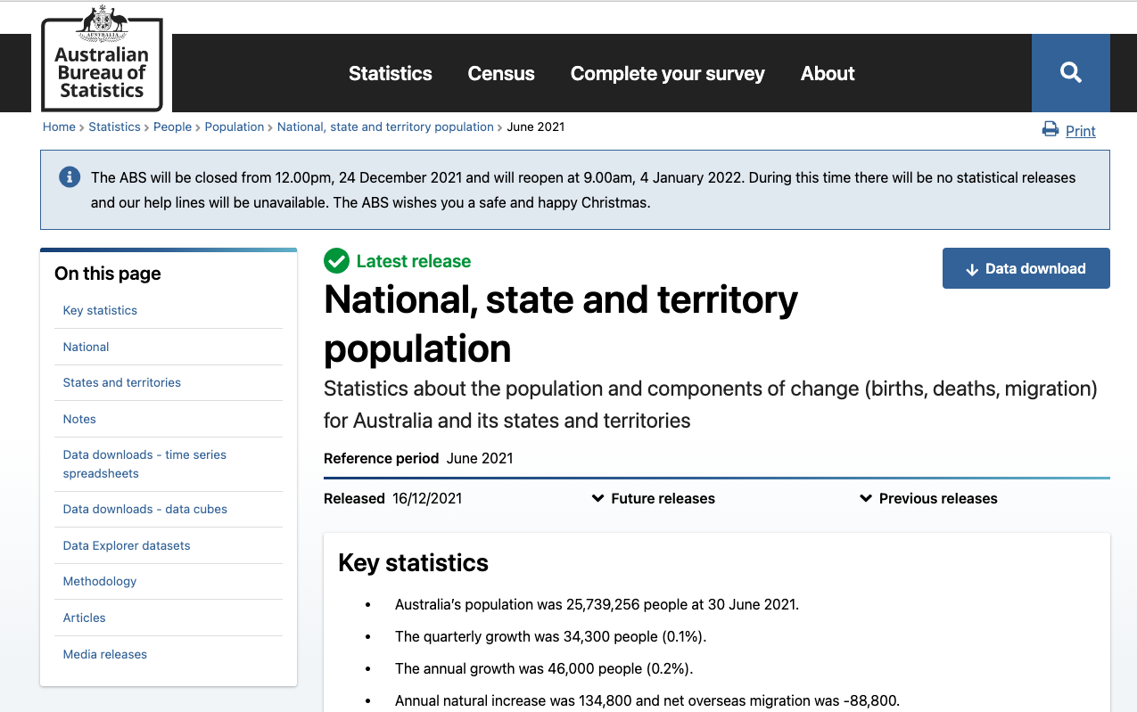
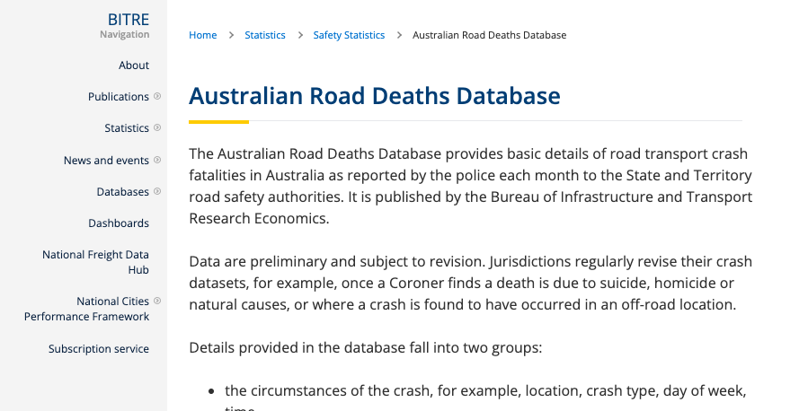

The Data
Australian Road Deaths
State Population Date
Bureau of Infrastructure, Transport, Regional Development and Communication
Australian Bureau of Statistics

Slide 4
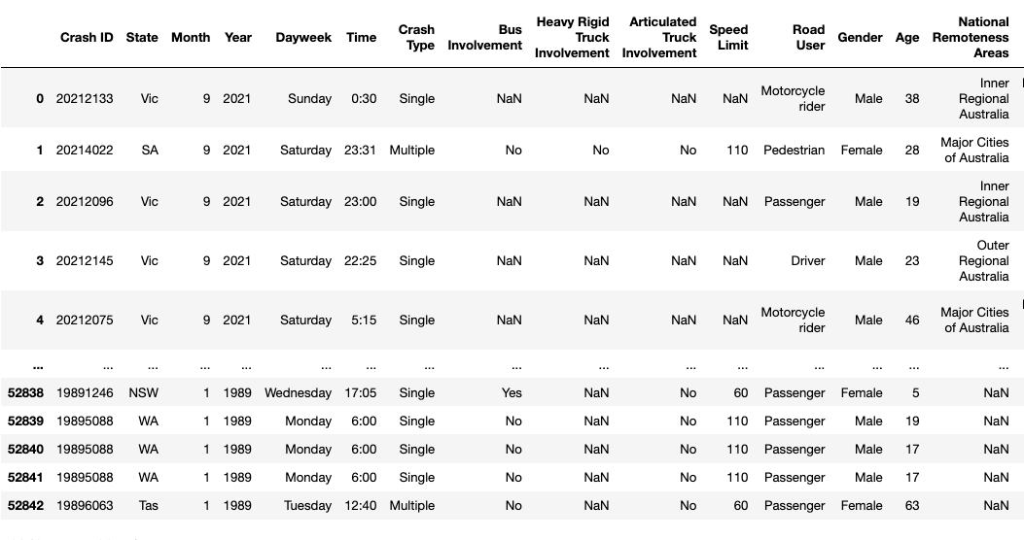
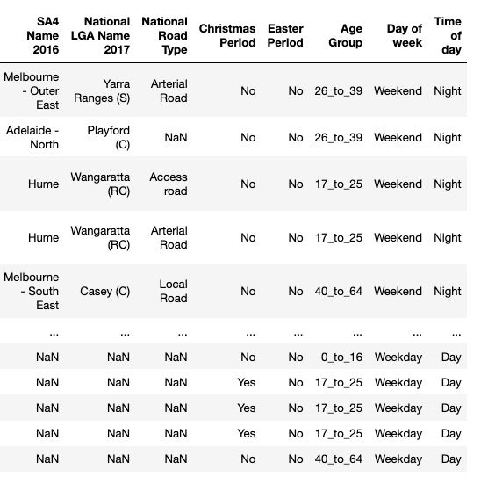
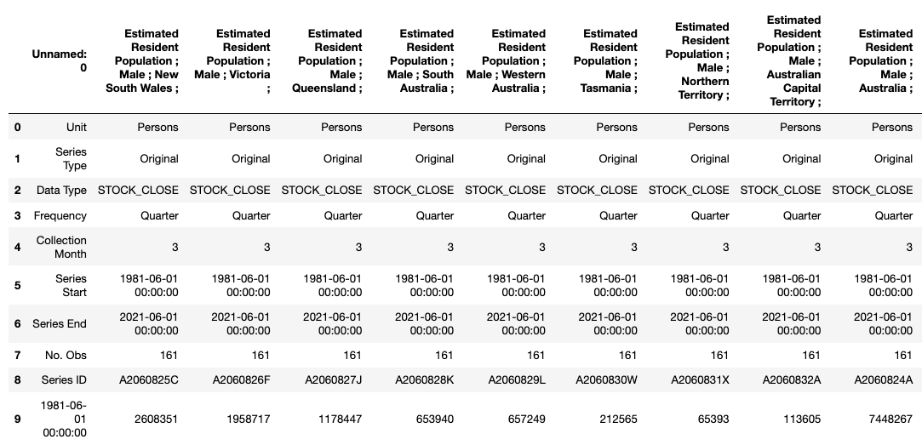
The Data continued…
Crash Data
Shape (52843,23)
Population
Notes:
The crash dataset was based on incident. The population dataset was based on 3-month periods with extraneous data in the top rows. It was segmented into columns by state and sex. A lot of cleaning had to occur to join the two.

Slide 5
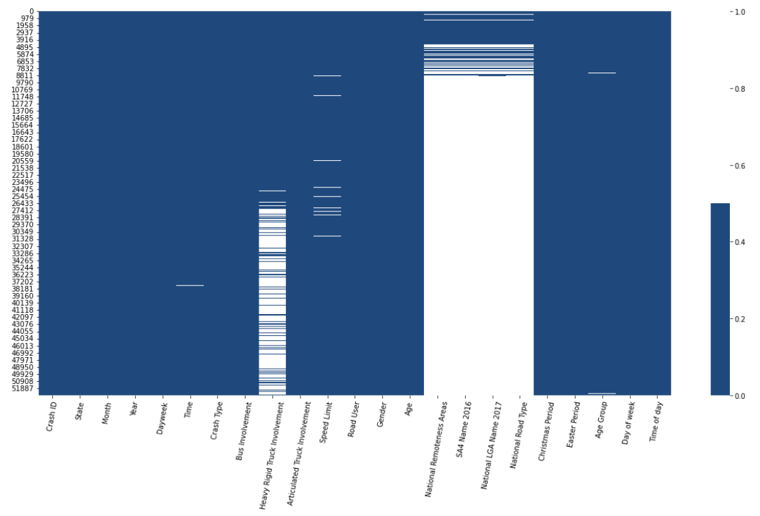
Data Exploration
Crash Dataset Columns
Crash ID - 0
State - 0
Month - 0
Year - 0
Dayweek - 0
Time - 0
Crash Type - 0
Bus Involvement - 0
Heavy Rigid Truck Involvement - 39
Articulated Truck Involvement - 0
Speed Limit - 1
Road User - 0
Gender - 0
Age - 0
National Remoteness Areas - 87
SA4 Name 2016 - 87
National LGA Name 2017 - 87
National Road Type - 87
Christmas Period - 0
Easter Period - 0
Age Group - 0
Day of week - 0
Time of day - 0
Notes:
We plotted the empty to understand what was missing. We found that certain columns were added over time. Knowing this, we could reduce the timeframe based on the periods for which the data was collected – if we wanted to glean information from those new fields.

Slide 6

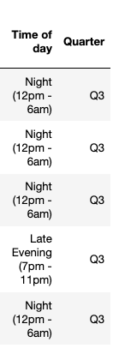
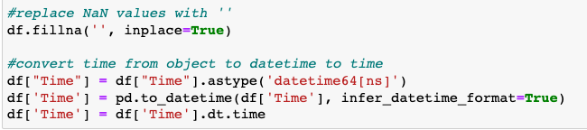
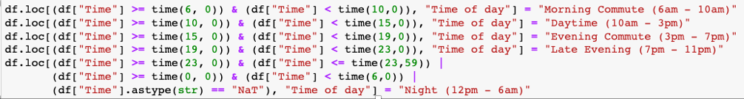
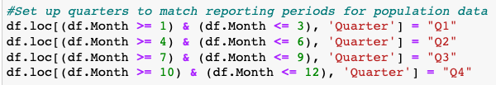
Cleaning (crash dataset)
Formatting Time
Adding Time of day
Adding Quarter
Notes:
Crash dataset was fairly clean and useable. We just needed to remove NaN values and convert time to format that could be compared.
The quarters were added so the population dataset could be merged based on state/year/quarter because that’s how the population data was collected.

Slide 7
Population dataset clean (Kelly)

Slide 8
Merging dataframes (Kelly)

Slide 9
Analysis Process
Summary Stats (Kelly and anyone else)

Slide 10
Analysis Process
Time Summary (Kelly)

Slide 11
Analysis Process
Demographic summary (Kevin)

Slide 12
Analysis Process
Geographic Summary (Hatim)

Slide 13
Conclusions: What aspects seemed to make a difference: time,
geography, demographic, etc (Kelly, Hatim, Kevin)

Slide 14
Implications (Not sure what this means… Kelly, Hatim, Kevin

